Slide 1

Calories Counter Website Team ID:6 Nikita Goyal Maryam Albakhiet

Slide 2
Motivation
We are consuming a lot of unhealthy food and to keep track of our health we need to know what type of food we are consuming each day. How many calories we are intake. So, our Calorie Counter Website will help the users to keep track of their daily calories' intake. Hopefully by that, they can watch their weight and live healthier lives with our website.

Slide 3

Objective
Building the calories counter website which includes certain features:
Recipe generator
Searching food calories
Calories counter
BMI calculator
Keto Diet
Exercise

Slide 4

Difference
Differences from existing projects:
Target calorie
Recipe generator
Exercise video posting

Slide 5
Architecture
Presentation Layer/User Interface
(HTML, CSS, JAVASCRIPT)
Application Logic Layer
Data Access Layer

Slide 6

Demo

Slide 7
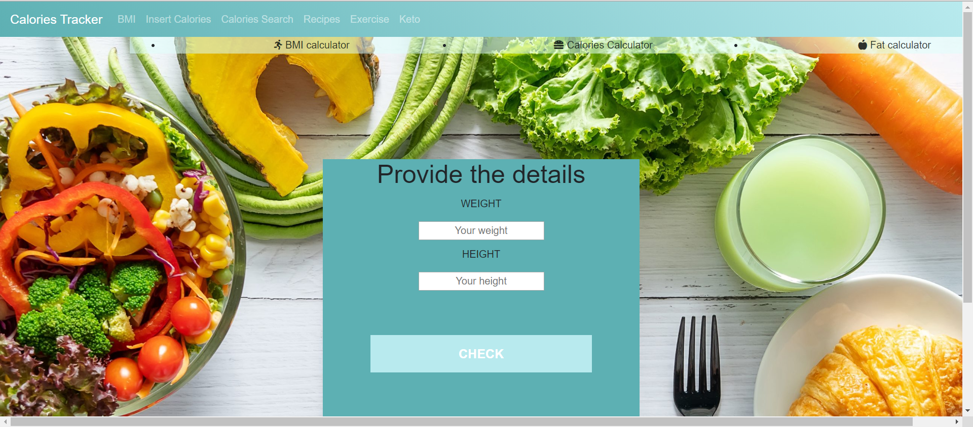
Demo

Slide 8
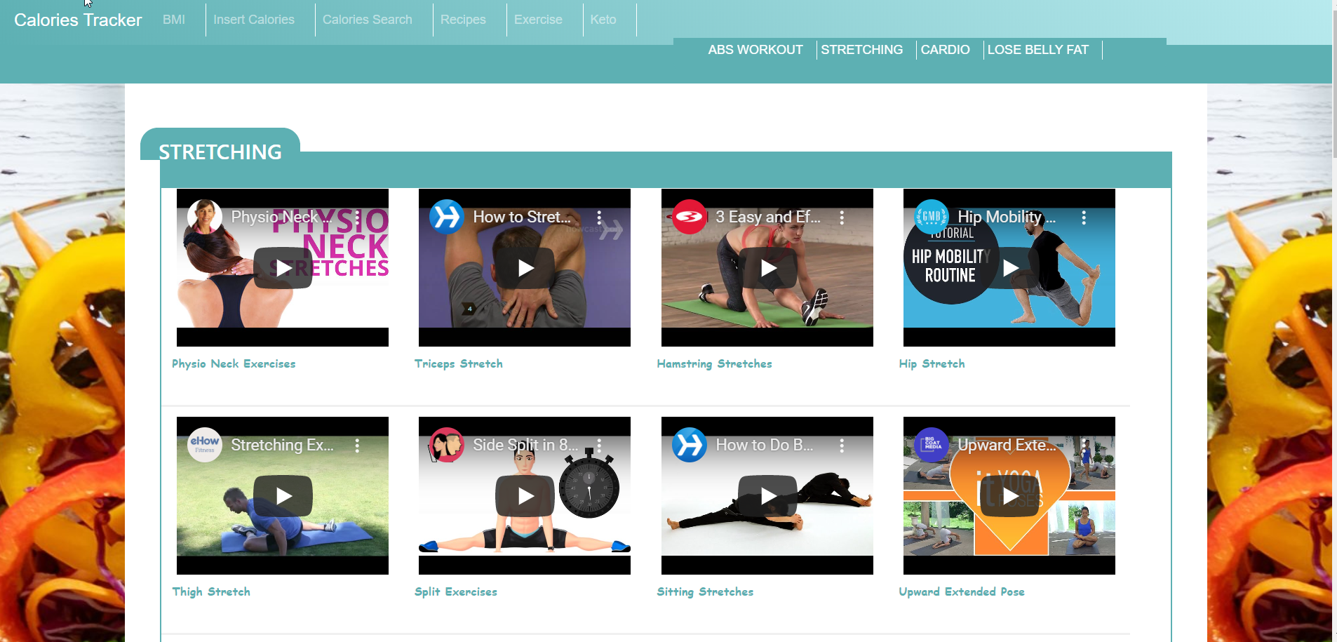
Demo

Slide 9
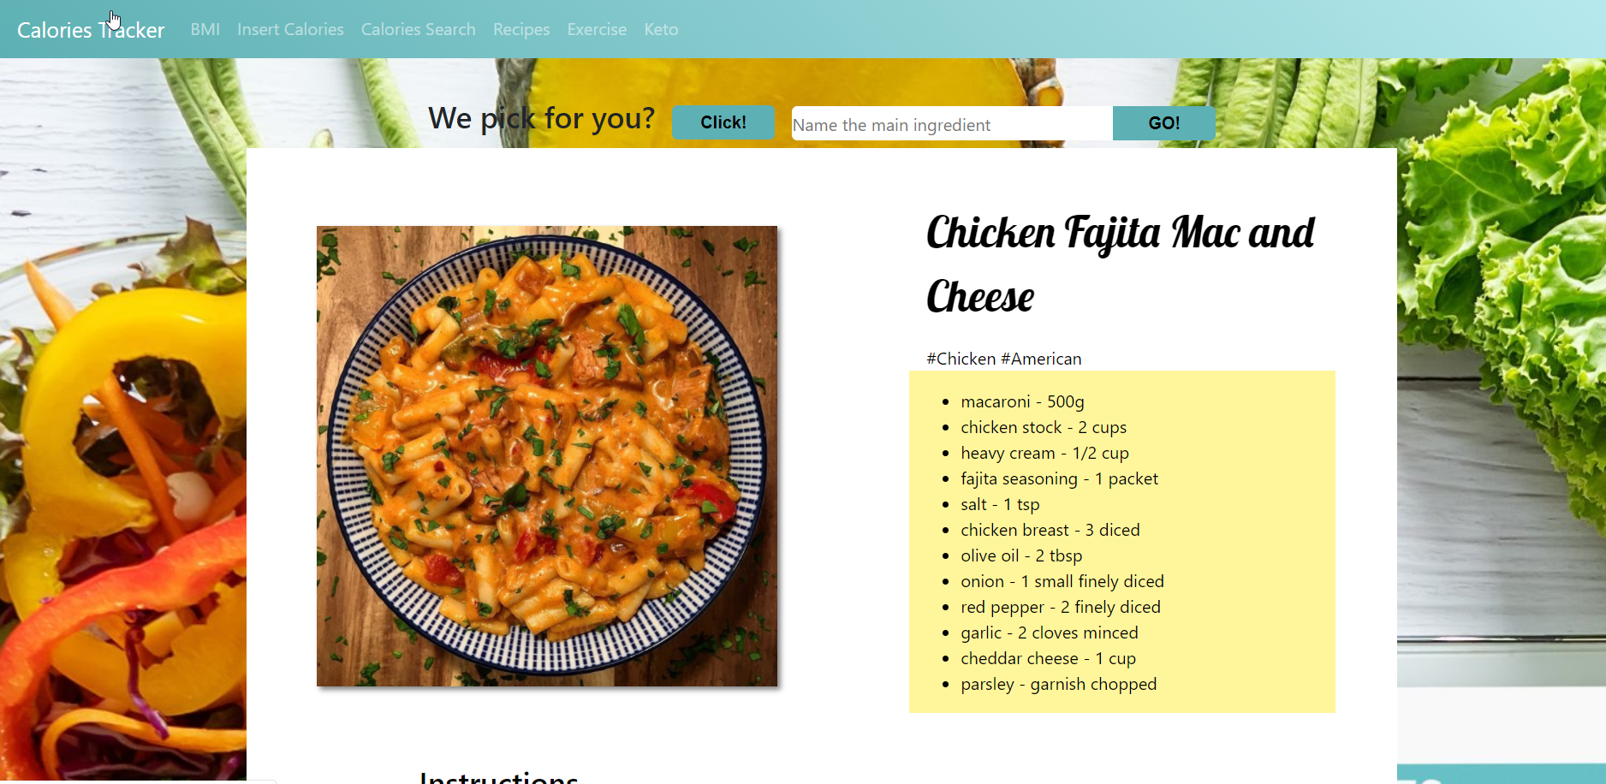
Demo

Slide 10
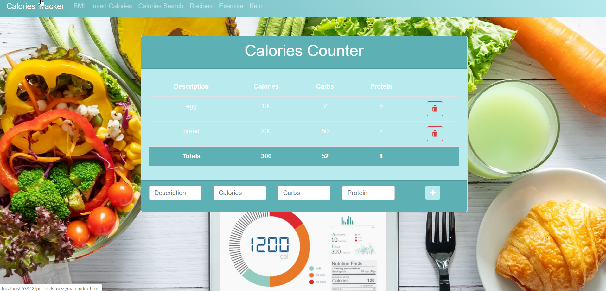
Demo

Slide 11
Contributions
We evenly divided the project pages to build between me and my teammate and then we will collaborate the whole project together. Since, we are only two members in a team. We will try to do our best to achieve our goals for this project.

Slide 12
References
https://www.webmd.com/diet/healthtool-food-calorie-counter
https://play.google.com/store/apps/details?id=com.myfitnesspal.android&hl=en_US
https://www.my-calorie-counter.com/
https://www.calculator.net/calorie-calculator.html
https://www.cancer.org/healthy/eat-healthy-get-active/take-control-your-weight/calorie-counter-calculator.html
https://www.myfitnesspal.com/

